Slide 1

Library
Management
System

Slide 2






Company Overview
Security
01
04
Development
Issues
02
05
AWS Cloud
Demonstration
03
06

Slide 3
01
COMPANY OVERVIEW

Slide 4
Introduction
A library management system is about organizing and managing all library oriented tasks. This includes maintaining the database by entering new books as well as keeping the records of books that have been returned/issued along their respective dates.
A Library Management System gives management access to the resources within your library. A well-developed system will increase your library’s efficiency, save valuable administration time, and enhance the educational user experience all while promoting independent learning.

Slide 5

Scope
To create distinct product users based on their roles and permissions.
• Authenticate users at the login page
• Provide a list of books a user can borrow
• Ability to reserve books that are available
• A status page that provides the following
Reserved books, borrowed books, book return due dates, book fines
• Provide ability to adjust account settings such as passwords
• Create mechanism to allow password resets in the event of a forgotten password
• Provide interface to add or delete books to list

Slide 6
Advantages
Record Maintenance All records related to the book issue/return deadline can be managed by the authorized personnel. The system also allows to record any fines penalized to the customer within the management system allowing for easier reporting between the Library’s departments.
Web-Based Solution Since the system is web based, no physical installation is required. An educational institution would only require a desktop, tablet or mobile device, along with a secure internet connection to access the site.
Saves Time and Cost Eliminates paper-based processes while reducing operation time and costs. Library becomes free of physical registers/files
Secure and Reliable A paper based process is susceptible to physical data loss, however, in the case of a web-based Library Management System, it is much secure and reliable.
Increases Efficiency The library management system enables authorized users to keep proper records of book details such as edition type, number of copies, issue/return dates and various fines that are charged.

Slide 7

Project Description
Library Management System Web Application
-An application designed to manage all the functions of a library such as maintaining data of books issued to users and display available books in the library.
-Display team’s effectiveness in maintaining a database with security practices to ensure the data is secure from common attacks.
-Showcase the team’s skill in web development and hosting by having the project accessible by the internet along with all protocol necessary to fit industry standards.

Slide 8
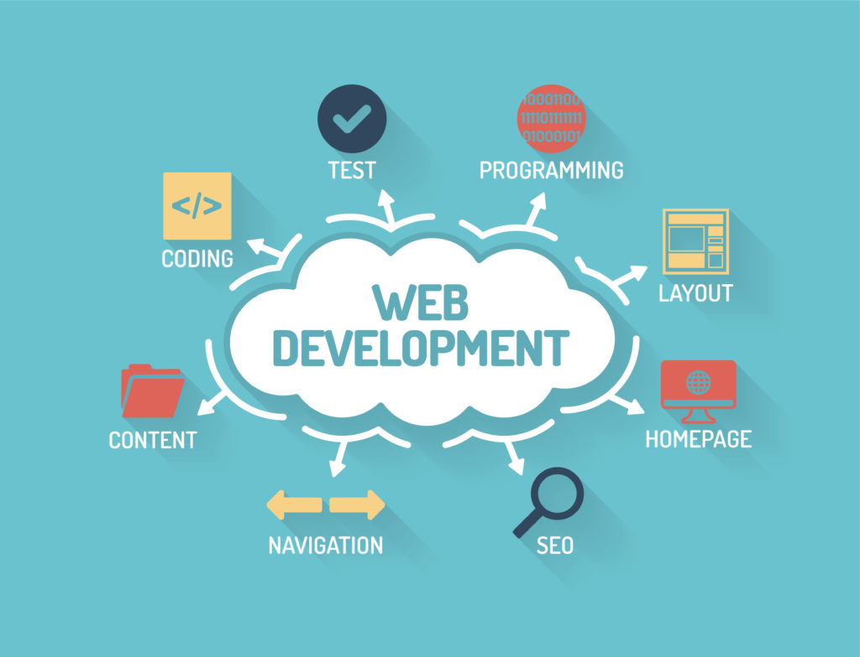
Project Lessons Learned
Established Effective Communication Skills: to ensure team complete tasks in a manner that is efficient and consistent with our end goals.
Problem-Solving and Decision-Making: throughout the course of the project many changes and issues were introduce. Ranging from deployment issues with apache or frameworks capability to time difficulties. All of these issue and more were obstacles the team needed to prevail in order to meet the desire goals set for the project.
Deeper learning:
Along with the team learning how use and maintain mysql database, php, bootstrap, apache and other team management skills.

Slide 9

02
DEVELOPMENT

Slide 10
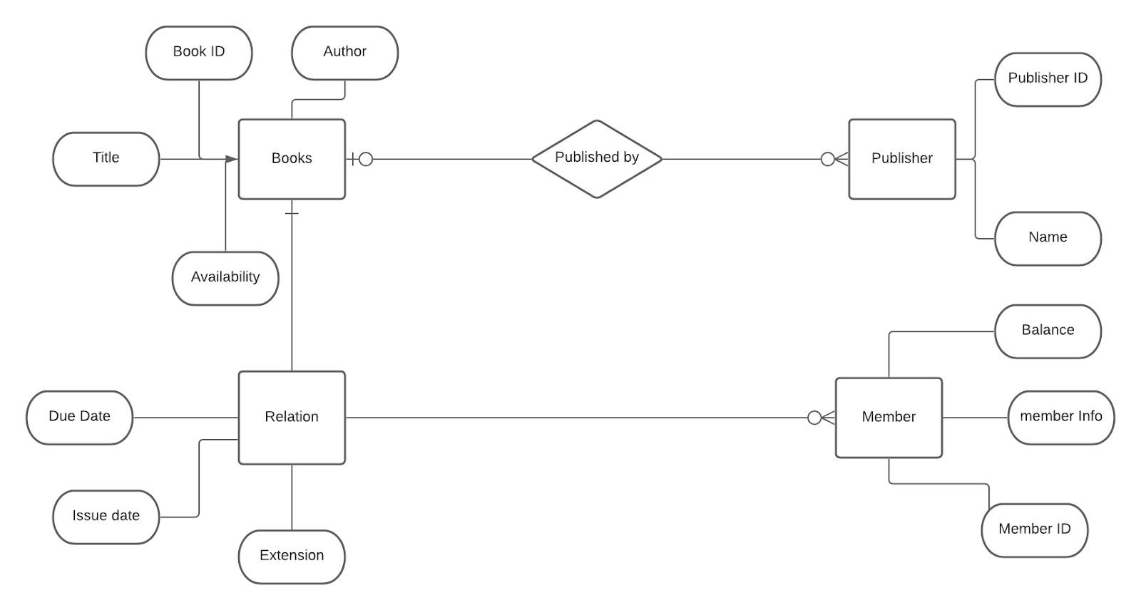
ERD CHART

Slide 11
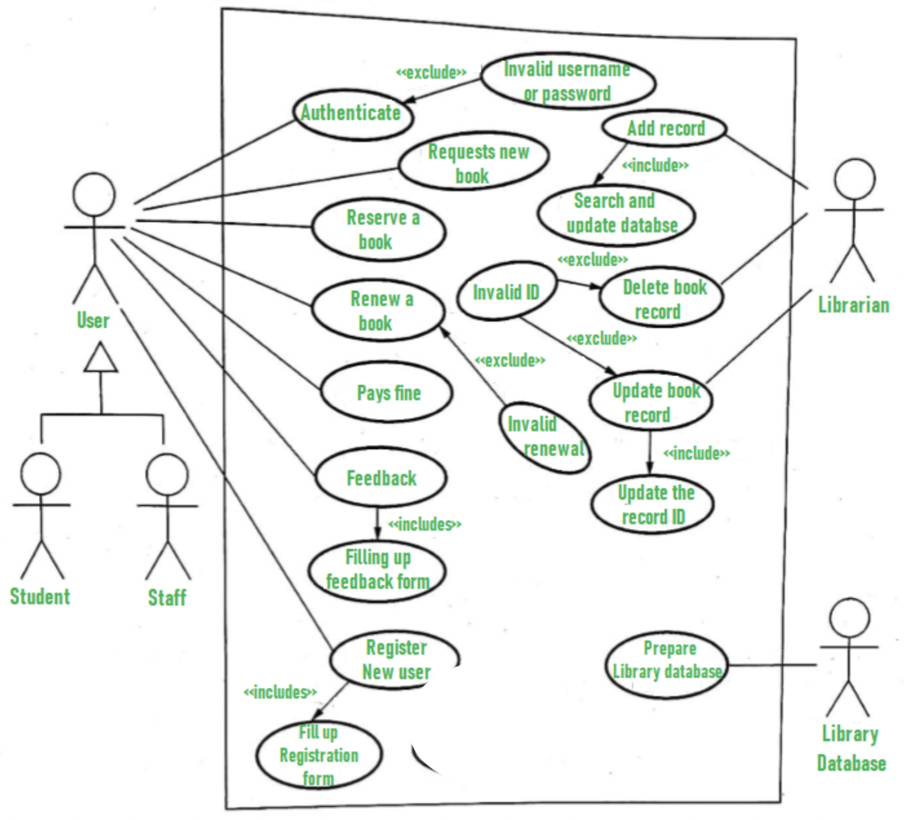
Case Diagram

Slide 12

Why php?
Easy to learn and use
Open source (and therefore free!)
It’s versatile
Fast and secure
Easily able to connect to databases
Tried and tested

Slide 13

Why mysql?
On-Demand Scalability
High Availability
Rock-Solid Reliability
Quick-Start Capability

Slide 14
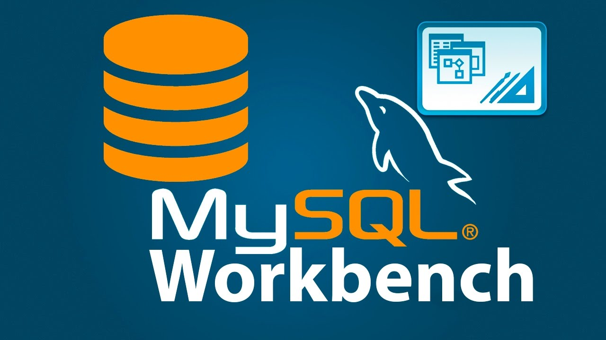
MySQL Workbench
Enables the user to interact directly with the database
Create and make changes to tables
Extract information from tables
Provide help creating SQL statements
Create ERDs
We’ll use SQL workbench to Create and execute SQL commands
View query results
But we won’t use it for modeling we want to do some things ourselves!

Slide 15

Bootstrap
An open-source CSS framework for front-end web development that is responsive and mobile-first. The team choose bootstrap for its design templates for navigation, forms, buttons,and other interface elements that are based on CSS and JavaScript.

Slide 16
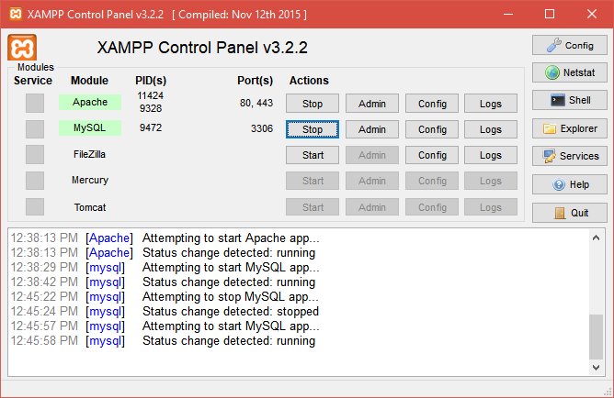
XAMPP
XAMPP for local development
It allows the team to develop our site locally on our own computer for testing purposes. Allow member to customise the setup without worrying that it'll affect other members. Make preparation for deploying the site and all contents into a live server.

Slide 17

03
AWS
CLOUD

Slide 18
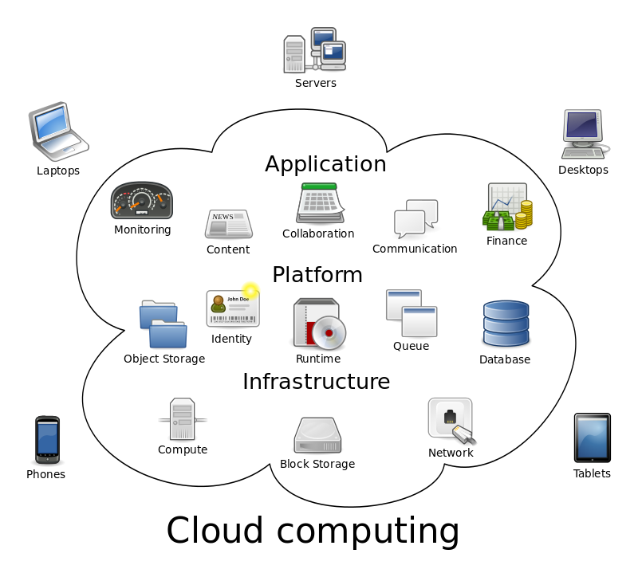
Cloud Computing
A way to access shared pools of configurable resource over internet.
Minimize up-front IT infrastructure
Enable organizations to focus on their core businesses

Slide 19





EC2 Features
Elastic Web-Scale Computing
Increase or decrease capacity within minutes
Automatically scale your application up and down depending on its needs
Secure
Cloud Security at AWS is at highest priority
EC2 works in conjunction with Amazon VPC to provide security
Reliable
EC2 is integrated with most AWS services such as
S3
RDS
VPC
LAMBDA and many more
EC2 Bytewire Configuration
Ubuntu 20.04 (allows LAMP)
t2.micro free tier
AWS Elastic IP to EC2

Slide 20

AWS RDS
RDS
RDS is a managed Relational database service that is simple to deploy, easy to scale, reliable and cost-effective
Choice of Database Engines
Managed Service
Easy to Scale and Operate
High Performance
High Availability
Amazon Relational Database Service (RDS)
RDS Manages BackUp, Software Patching, Auto Failure Detection and
recovery.
User have Automatic Backup and manual Backup Options.
RDS Supports below RDBMS -
MySQL
MariaDB
Oracle
MS SQL Serve

Slide 21



LAMP
We are using LAMP stack which is a Web-Server
Sometimes Perl or Python is also used instead of PHP.
Linux (Ubuntu)
Apache
MySQL
PHP

Slide 22


Domain Name and SSL Certificate
Freenom is the world's first and only free domain provider. Our mission is to bring people online and help countries develop their digital economy.
By breaking barriers and integrating free domains with the latest website building and hosting technologies, Freenom makes it easy for any business or individual to build websites and content, at no cost.
OpenSSL is a software library for applications that secure communications over computer networks against eavesdropping or need to identify the party at the other end. It is widely used by Internet servers, including the majority of HTTPS websites.

Slide 23

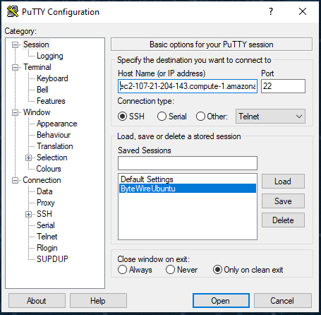
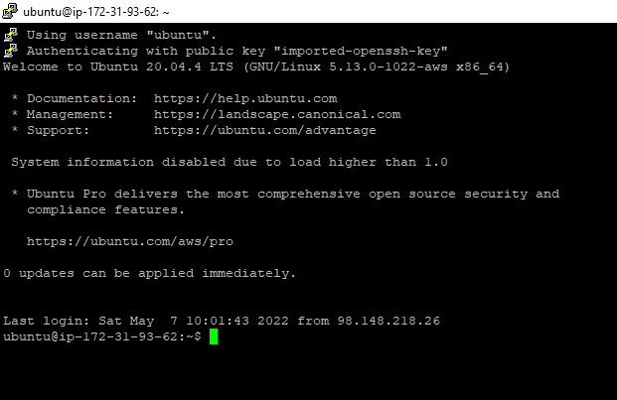
Putty
SSH (with auth file)
Port (22)
AWS .pem converted into PUTTY .ppk file (AUTH)
Elastic IP to save session

Slide 24
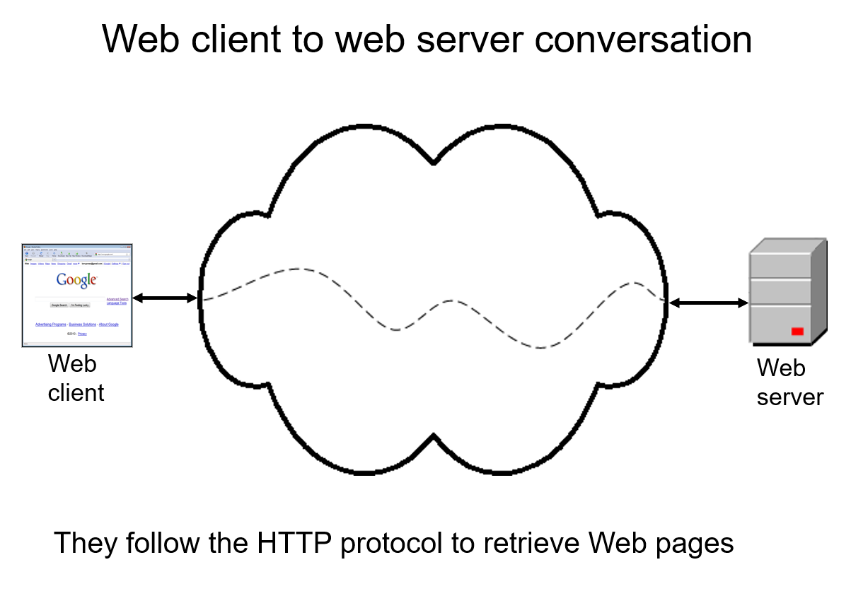

FileZilla
FileZilla is a File Transfer Protocol program available for free.
IT concepts: client-server review, file transfer protocol (FTP), Website mirror, portable software, open source repository
Internet concepts
–Applications
–Technology (FTP)
–Implications
Internet skills
–Application development (Web)
–Content creation

Slide 25
04
SECURITY

Slide 26
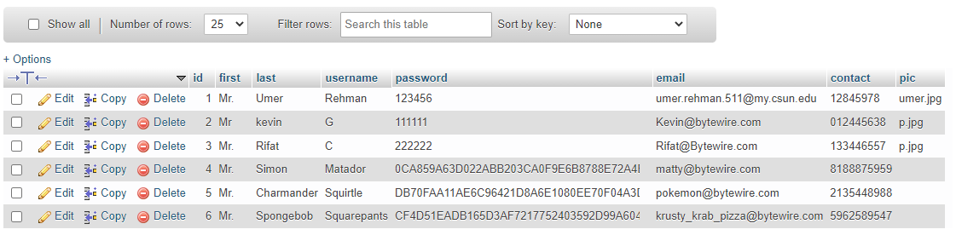

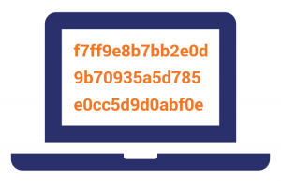
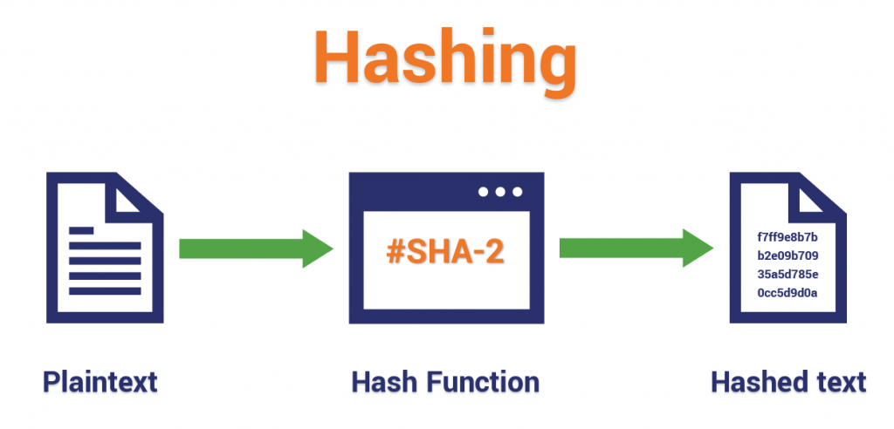
Password HASH

Slide 27
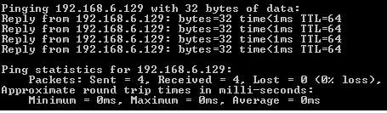
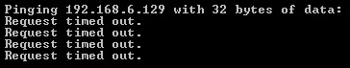
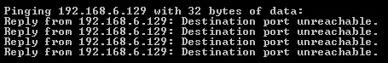
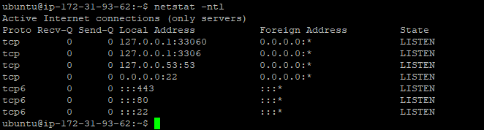
IpTables
Allow
Drop
Reject

Slide 28
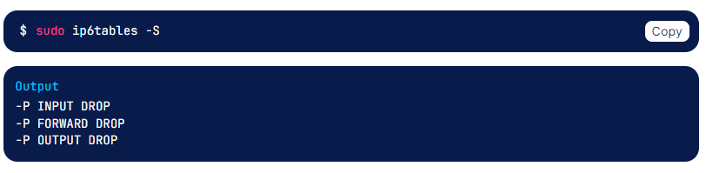
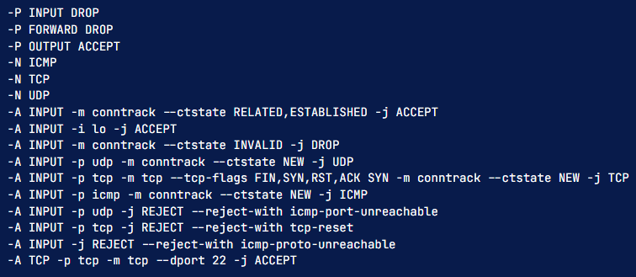
IpTables
Ipv6
Ipv4

Slide 29
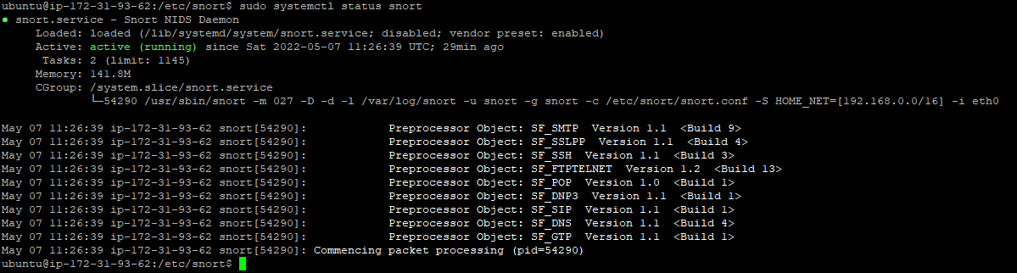
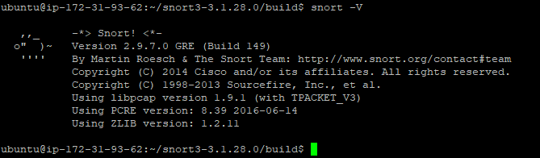
Snort

Slide 30
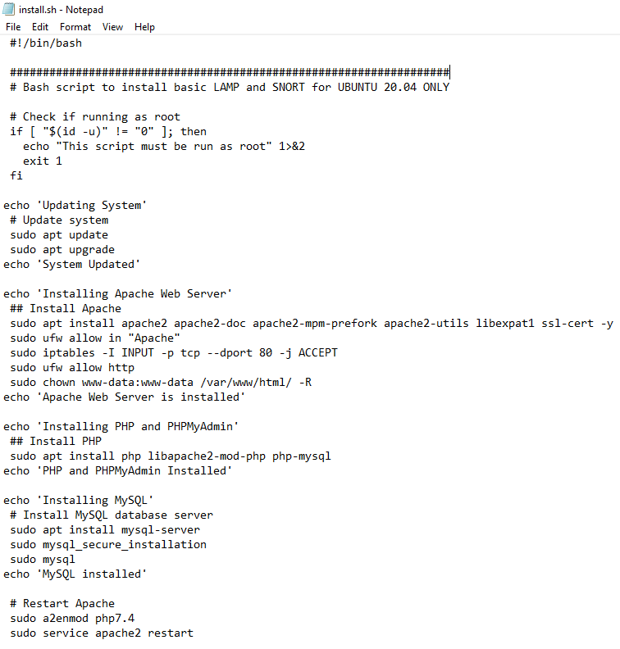
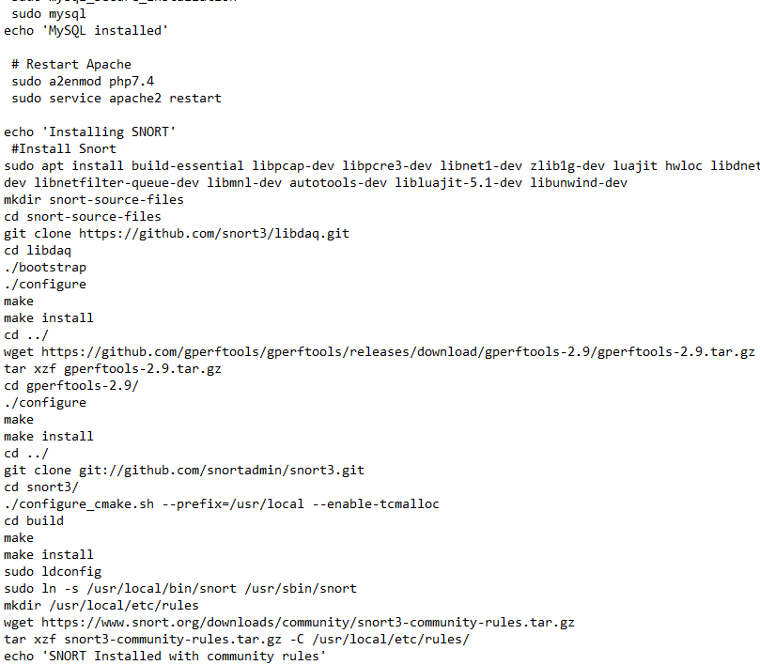

Backup Shell Script File
Rifat Chowdhury

Slide 31
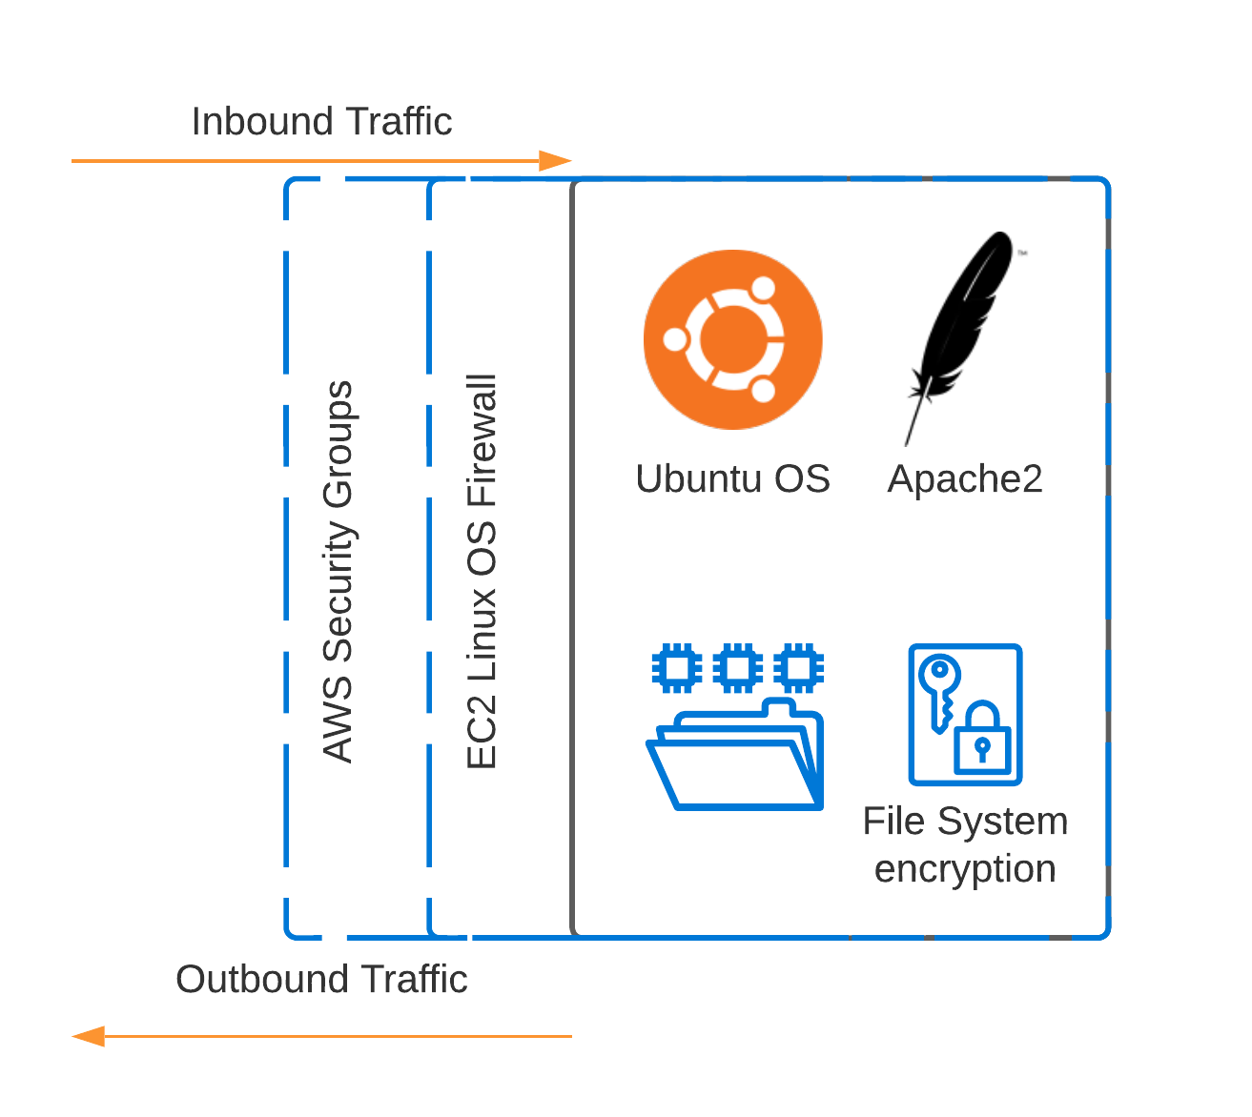
AWS Network Traffic Flow Security
Security Groups: acts as a virtual firewall for our EC2 instances to control incoming and outgoing traffic. The Inbound rules help control the incoming traffic to our instance, and outbound rules control the outgoing traffic from our instance.
VPC: AWS Virtual Private Cloud allows us to define network connectivity and restrictions between the web servers and databases.
*Provides Team full control of a flexible security layer
*Logs network events
*Implement stateless filters by specific protocols, ports and IP Address to ensure strict access to EC2 and RDS database

Slide 32
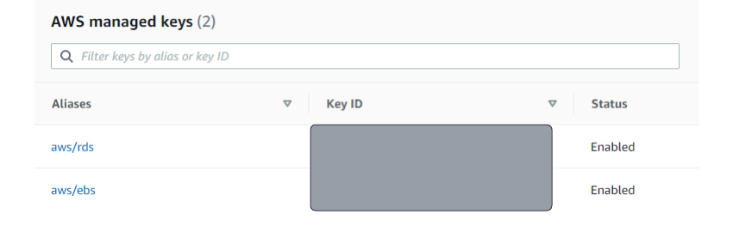
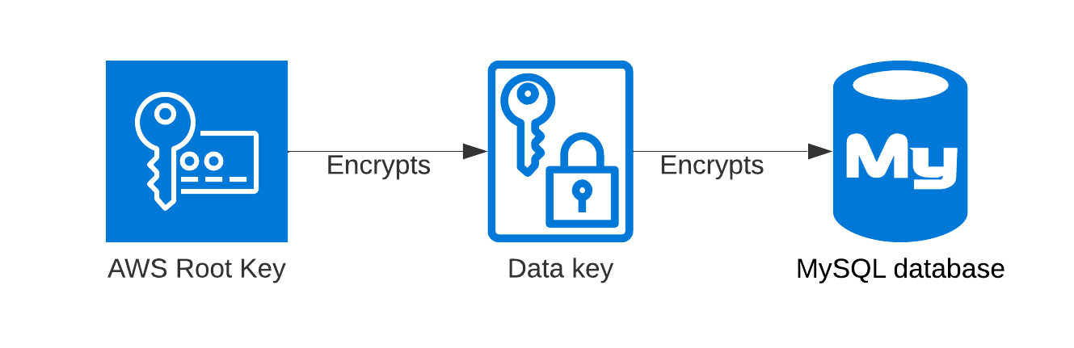
Amazon Key Management (DB)
AWS Key Management: A service that allow the team to create and control the encryption keys that are used to encrypt our project’s data. For this instance created keys to encrypt both our RDS and EC2 storage EBS.
*Amazon EBS for data that must be quickly accessible and requires long-term persistence
*Helps the Team to create, control and delete keys, which encrypt the data stored in AWS EC2 and mySQL database.
*Provides Client-Side Encryption where we can encrypt the data at the client-side and sends it securely to the project EC2 web server or RDS database.
*AWS by default will provide Server-Side Encryption for the keys, allowing us let the backend service to encrypt the data and manage those keys on our behalf.

Slide 33
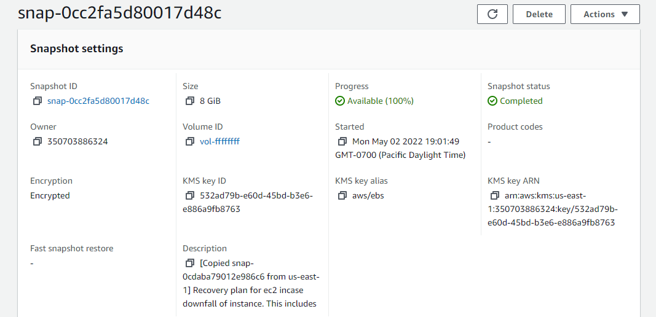
EC2 Snapshot
*EBS volumes are the primary persistent storage option for Amazon EC2
*The Snapshot feature allows the team to take point-in-time backups of our data. All EBS volume types offer durable snapshot capabilities and are designed for 99.999 percent availability
*This servers as the team’s Incremental backups due to limitations of IAM Roles
*As an incremental backups, they only back up the blocks on the device that have changed since the previous snapshot.
*AWS key encryption is setup to ensure server side security and protection of the project’s backup

Slide 34
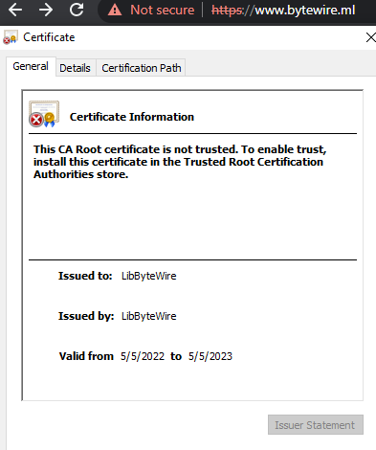
HTTPS/OpenSSL
HTTPS: Provides our server the use of Transport Layer Security it will encrypt normal HTTP requests and responses.
*It protects against man-in-the-middle attacks, and the bidirectional encryption of communications between a client and server protecting the communications against eavesdropping and tampering from outside threats
*Through the use of certificates, the TLS protocol aims to provide cryptography, including confidentiality, integrity, and authenticity for the two communicating computers
*Provides both a Secure Data Network System and Transport Security
*Due to IAM roles limitations set up by AWS learners lab, the team had to use a
self sign SSL certificate in order to enable the Transport Layer Security via OpenSSL

Slide 35
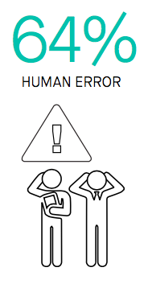
Addressing Human Error
As IT students we must focus on security and the integrity of our server. Along with the team’s setup of security policies to ensure the ec2 is protected by outside threats. There is still one threat that must be addressed, Human Error.
A single admin making a simple mistake had widespread impact across all applications in AWS EC2
Most AWS incident was due to an error in infrastructure configuration, When a mistake was made with infrastructure configuration it usually affects the core of the ec2 this includes Storage going down and services being interrupted

Slide 36
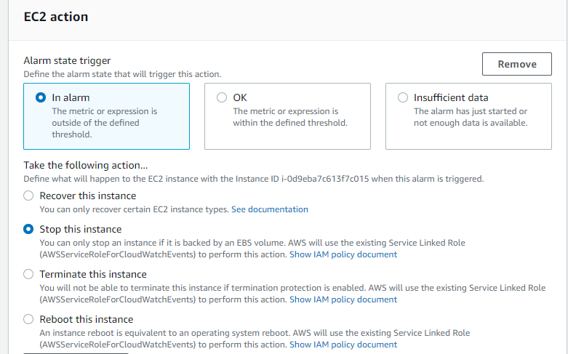
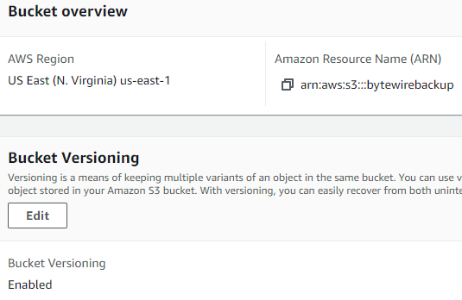
Bucket Versioning and AWS Cloudwatch
Bucket Versioning: In Amazon S3, versioning allows us to keep multiple versions of an object in the same bucket. Every version of every object stored in our buckets can be
*Preserved
*Restored
Allowing the team or others to recover from unintended user actions
AWS Cloudwatch: Enables users to collect and view monitoring data of the AWS infrastructure. This includes specific features for data collection, monitoring, analysis and setup of automated actions.
*Auto-shutdown of EC2 incase the server faces a high CPU usage a common sign of DOS attacks.
*Along with alerts to notify and address SQL Injections, TCP SYN flood attack, and Ping of death attacks

Slide 37
05
ISSUES

Slide 38
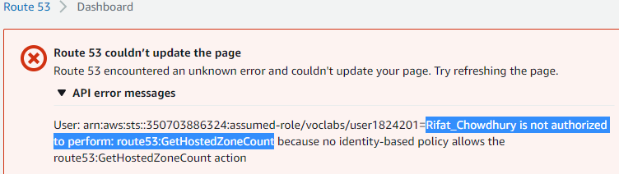
IAM Roles Limitation
What?
Resolution:
Problem:
IAM, also known as Identity and Access Management, provides us with a fine tuned access control system across the entire AWS site. With using IAM, we are allowed to control who can access which servers and resources based on set conditions. With this feature we manage permissions based on set privilege permissions.
SNORT Installation directly into the Operating System of the EC2

Slide 39

Cloudflare
Problem:
Cloudflare is used to proxy sites that rely on Amazon Web Services (AWS) to store static content using Amazon Simple Storage Service, also known as S3
With cloudflare, we must meet specific conditions
Our site must be associated with a registered domain
Our site has static content, this can include anything from images/HTML pages, so that we can add these to our S3 bucket
Cloudflare was incompatible with our free tier domain service

Slide 40
06
DEMONSTRATION

Slide 41

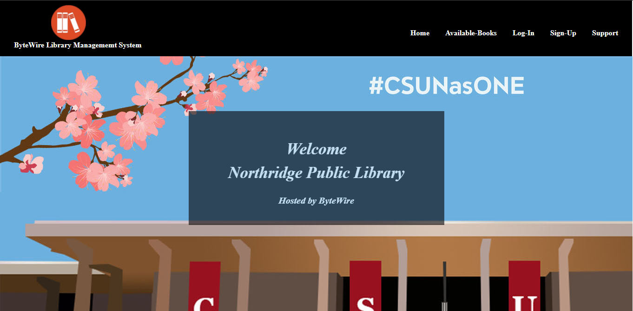
Website Home Page

Slide 42
Live Project Demonstration

Slide 43
THANKS!
Do you have any questions?
https://www.bytewire.ml/

